Slide 1
The Gastrointestinal System
Gross & Microscopic Anatomy, Core Physiology, and an Introduction to GI Diagnostics
PAS-523 Clinical Medicine II
Summer 2026
Lectured by Erik Hollers, PA-C
Assembled by Angela Hammett, PA-C

Slide 2
Learning Objectives
■
Describe the gross anatomy of the GI tract and its accessory organs.
●
Identify the wall microanatomy and specialized cell types of the esophagus, stomach, small intestine, and colon.
▲
Summarize neural & hormonal control of GI secretion, motility, digestion, and absorption.
◆
Recognize major imaging & endoscopic studies used to evaluate GI complaints.
GI System — Anatomy & Physiology
2 / 46

Slide 3
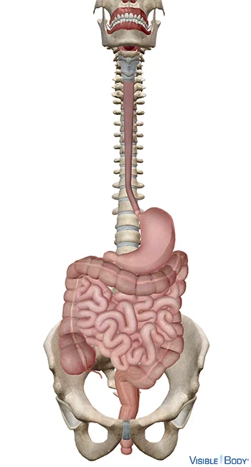
OVERVIEW
The GI Tract at a Glance
One continuous tube: mouth → esophagus → stomach → small intestine → colon → rectum
Sphincters keep flow moving one direction
Luminal pH shifts by region — gastric acid to intestinal neutral
Core jobs: ingest, digest, absorb, eliminate
GI System — Anatomy & Physiology
3 / 46

Slide 4
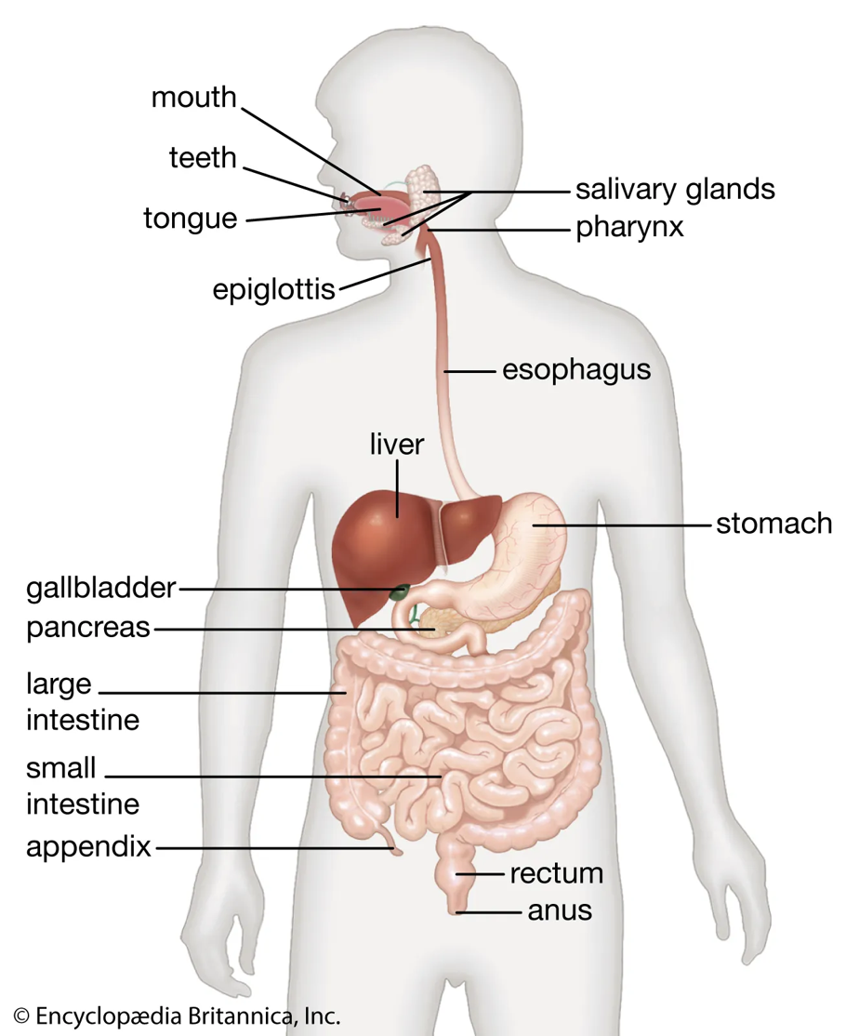
OVERVIEW
Accessory (Solid) Organs
Salivary glands — start carbohydrate/fat digestion
Liver — metabolism, detox, bile production
Gallbladder — stores & concentrates bile
Pancreas — digestive enzymes + insulin/glucagon
GI System — Anatomy & Physiology
4 / 46

Slide 5
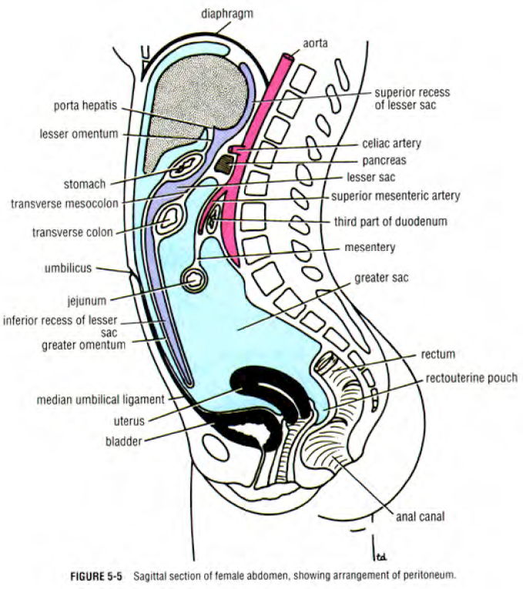
REGIONAL ANATOMY
Peritoneum & Abdominal Cavity
Parietal peritoneum lines the wall; visceral peritoneum covers organs
Greater sac vs. lesser sac (omental bursa)
Mesentery suspends the small intestine
Omenta drape from the stomach (greater = “abdominal policeman”)
GI System — Anatomy & Physiology
5 / 46

Slide 6
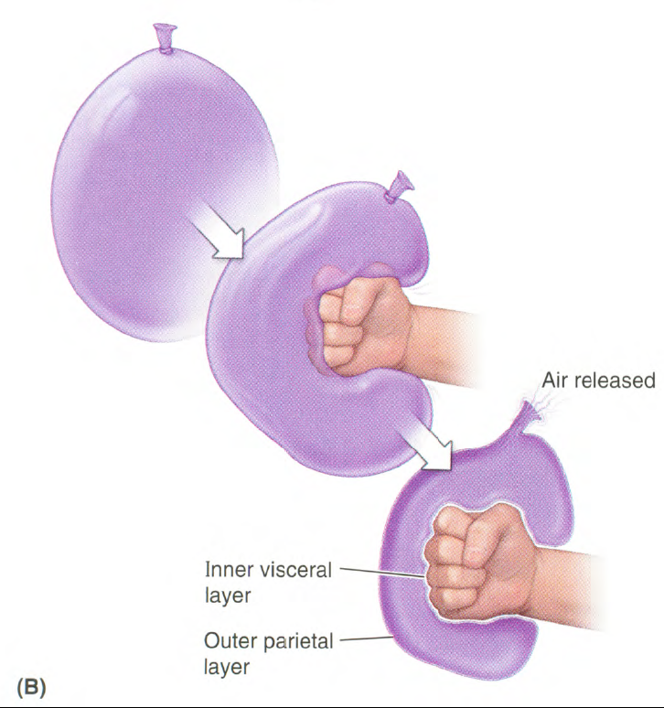
REGIONAL ANATOMY
Intraperitoneal vs. Retroperitoneal
Intraperitoneal: stomach, liver, spleen, jejunum/ileum, transverse & sigmoid colon
Retroperitoneal (“SAD PUCKER”): duodenum, ascending/descending colon, pancreas, kidneys
Distinction matters for surgical mobility & imaging planes
GI System — Anatomy & Physiology
6 / 46

Slide 7
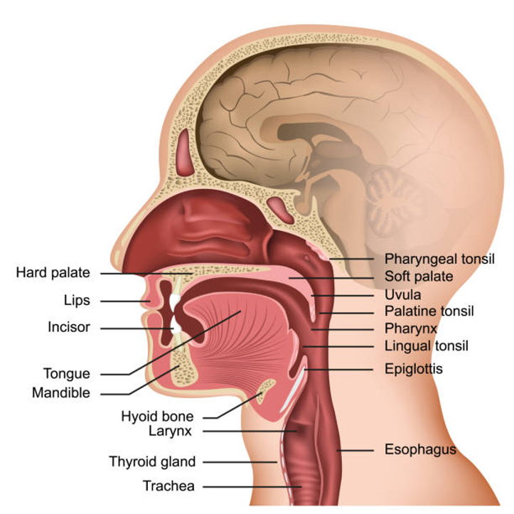
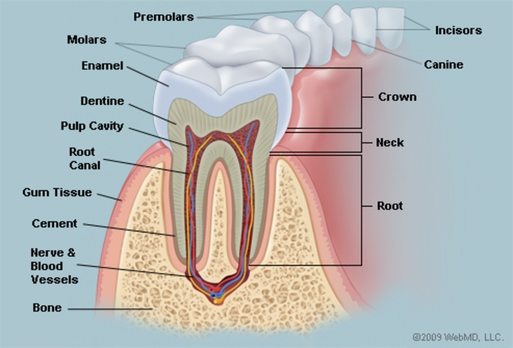
UPPER GI — GROSS ANATOMY
Oral Cavity & Salivary Glands
Teeth & tongue — mastication, bolus formation (CN V)
3 paired salivary glands: parotid, submandibular, sublingual
Saliva: amylase + lipase begin digestion; mucus & IgA protect
GI System — Anatomy & Physiology
7 / 46

Slide 8
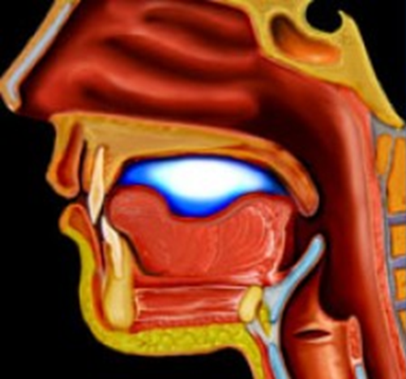
UPPER GI — PHYSIOLOGY (REVIEW)
Deglutition (Swallowing)
1. Oral phase — voluntary; tongue forms & pushes bolus
2. Pharyngeal phase — involuntary; epiglottis protects airway
3. Esophageal phase — involuntary peristalsis to stomach
GI System — Anatomy & Physiology
8 / 46

Slide 9
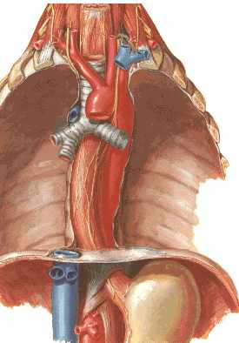
UPPER GI — GROSS ANATOMY
Esophagus: Gross Anatomy
~20–25 cm muscular tube, cervical → thoracic → abdominal
Passes through diaphragm at the esophageal hiatus (T10)
Joins the stomach at T11
Function: peristalsis transports the bolus — no digestion or absorption here
GI System — Anatomy & Physiology
9 / 46

Slide 10
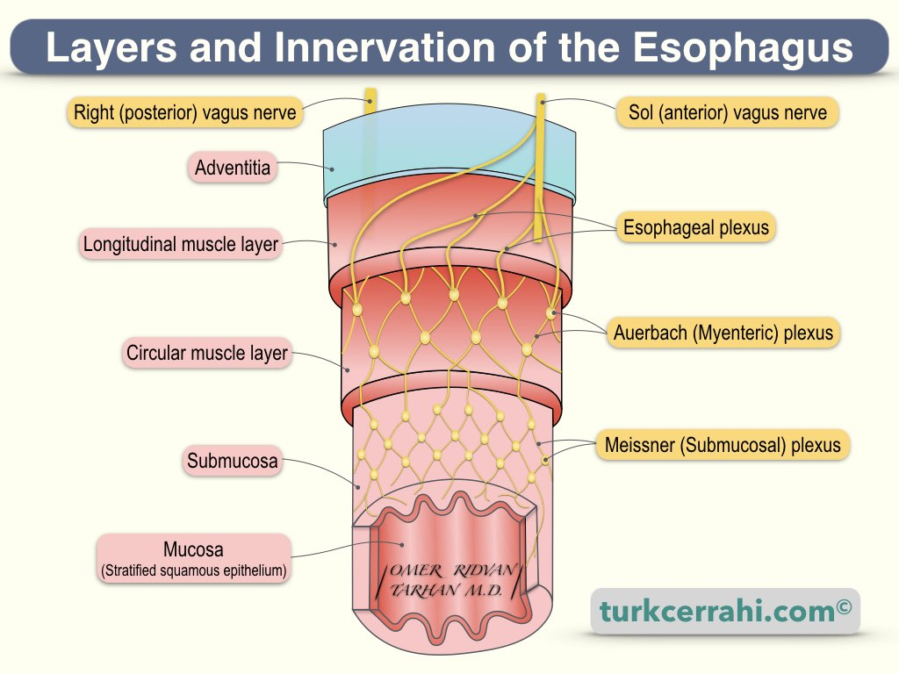
UPPER GI — GROSS ANATOMY
Esophagus: Layers and Innervation
Innervation by vagus nerve
→ esophageal plexus
→ Auerbach plexus
→ Meissner plexus
Layers:
Adventitia (outermost)
→ Longitudinal muscle layer
→ Circular muscle layer
→ Submucosa
→ Mucosa (innermost)
GI System — Anatomy & Physiology
9 / 46

Slide 11
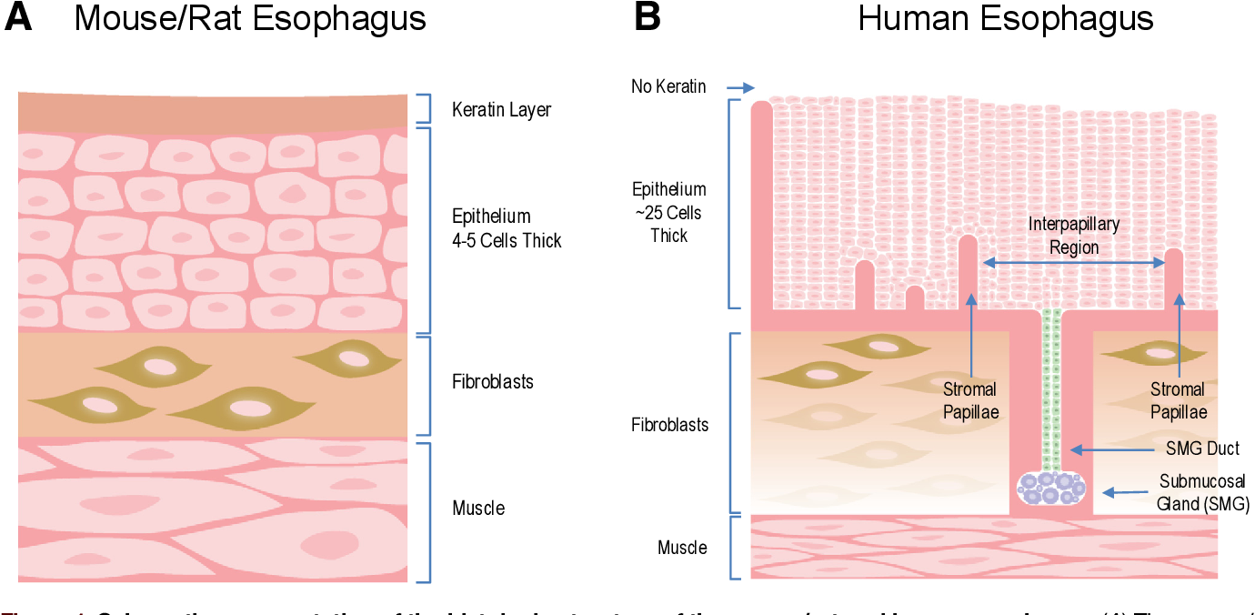
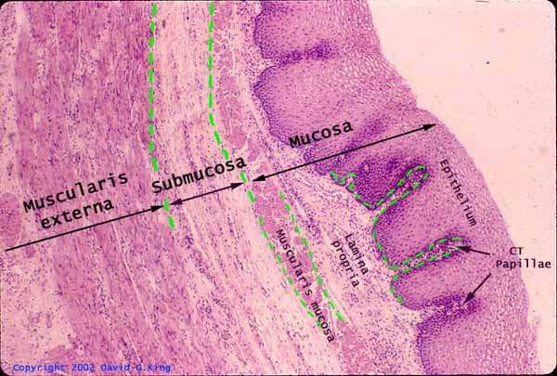
UPPER GI — Microanatomy
Esophagus: Microanatomy
Esophageal epithelium = nonkeratinized stratified squamous cells, many layers
Stromal papillae divide up the epithelium into regions
Submucosal glands secrete mucus, released into esophageal lumen
Fibroblasts and muscle cells are deeper
GI System — Anatomy & Physiology
9 / 46
Notes:
The human esophageal epithelium is nonkeratinized stratified squamous and comprises many cell layers. Stromal papillae divide the epithelium into regions overlying papillae and interpapillary regions. Secretions made by submucosal glands are carried by ducts, lined by cuboidal cells (shown in green), and released into the esophageal lumen. Fibroblasts and muscle are located deep to the epithelium.

Slide 12
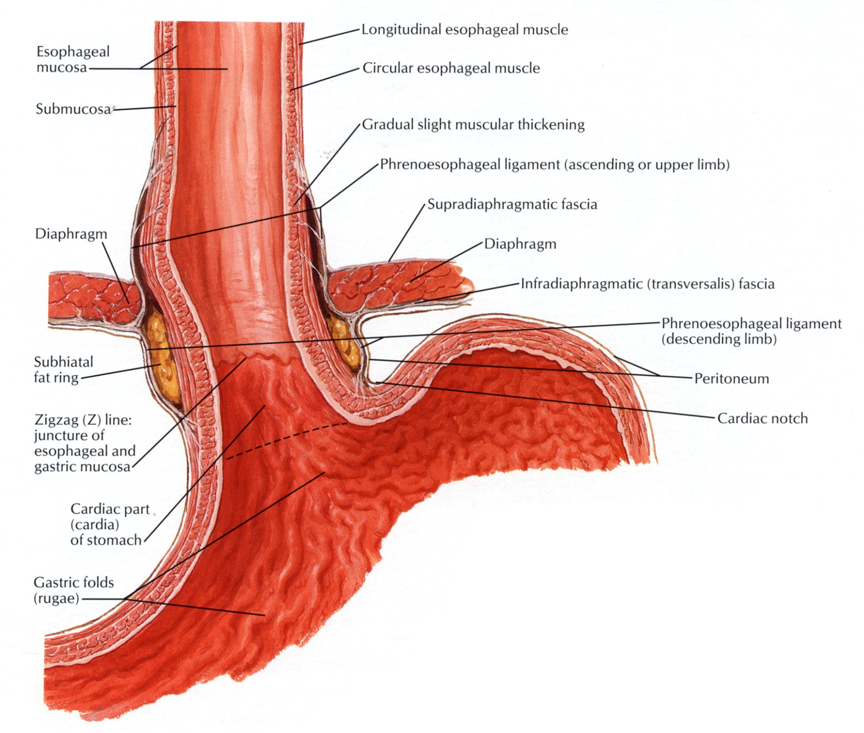
UPPER GI — GROSS ANATOMY
Esophageal Sphincters
UES (cricopharyngeus) — prevents air entry
LES — physiologic, not anatomic, sphincter
No true muscular ring at the GE junction — tone comes from the crural diaphragm and angle of His
GI System — Anatomy & Physiology
10 / 46

Slide 13
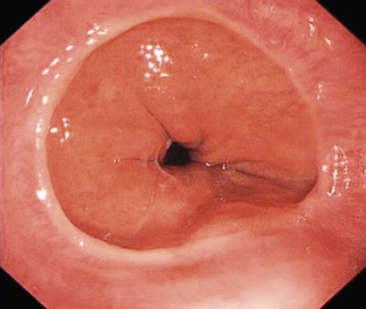
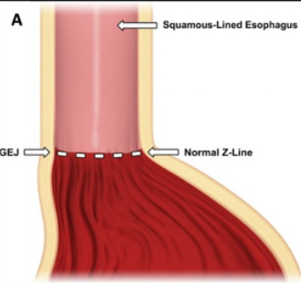
UPPER GI — MICROANATOMY
Esophagus: The Z Line
Squamocolumnar junction — esophageal vs. gastric mucosa
Esophagus: nonkeratinized stratified squamous epithelium
Stomach: simple columnar epithelium begins here
Key endoscopic landmark for Barrett's surveillance
GI System — Anatomy & Physiology
11 / 46

Slide 14
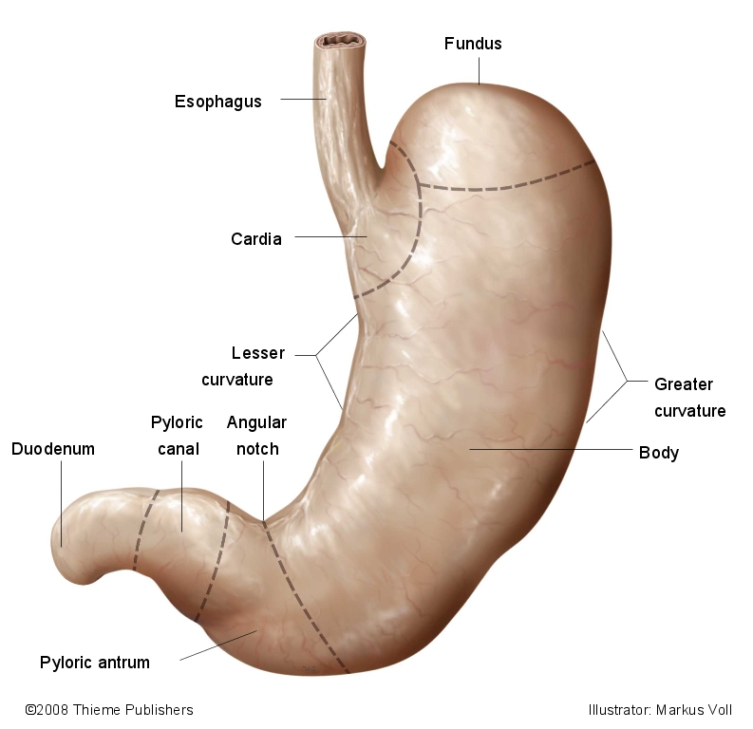
MIDGUT — GROSS ANATOMY
Stomach: Regions & Curvatures
Cardia → fundus → body → pyloric antrum → pyloric canal
Lesser curvature (right) & greater curvature (left)
Function: fundus stores swallowed air/food, body mixes & digests, antrum grinds and meters emptying
GI System — Anatomy & Physiology
12 / 46

Slide 15
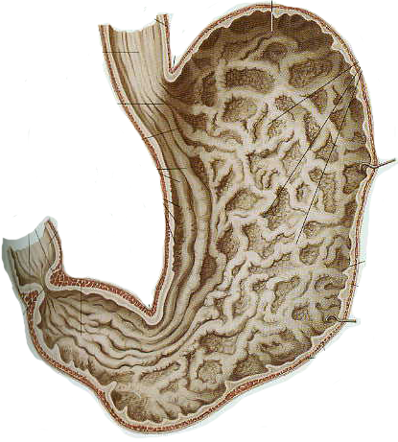
MIDGUT — GROSS ANATOMY
Stomach: Internal Surface
Rugae — mucosal/submucosal folds
Flatten out as the stomach distends with food
Gastric pits open along the entire surface
GI System — Anatomy & Physiology
13 / 46

Slide 16
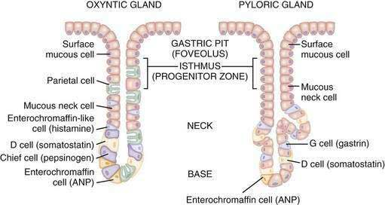
MIDGUT — MICROANATOMY
Gastric Mucosa: Specialized Cells
Mucous cells — protective mucus & bicarbonate
Parietal cells — HCl + intrinsic factor
Chief cells — pepsinogen → pepsin: begins protein digestion
G cells (antrum) — gastrin
GI System — Anatomy & Physiology
14 / 46

Slide 17
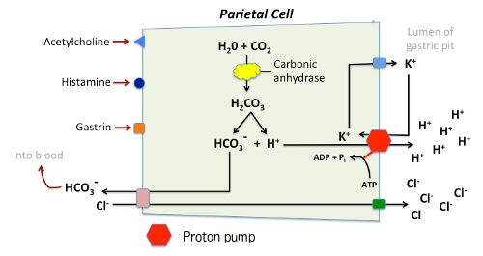
MIDGUT — MICROANATOMY
Gastric Pits in Detail
Surface epithelium invaginates to form gastric pits/glands
Each gland empties acid, enzymes & mucus into the pit
Rich capillary network supports high secretory demand
GI System — Anatomy & Physiology
15 / 46

Slide 18
MIDGUT — PHYSIOLOGY (REVIEW)
Gastric Secretion & Motility
Secretion (3 phases)
Motility
Cephalic — sight/smell/taste, vagal
Gastric — distension, gastrin release
Intestinal — feedback inhibition
Receptive relaxation of the fundus
Mixing waves → chyme
Migrating motor complex between meals
GI System — Anatomy & Physiology
16 / 46

Slide 19
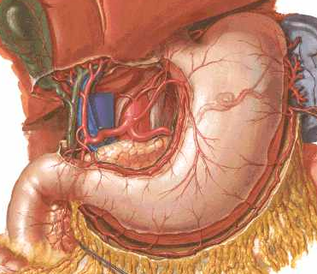
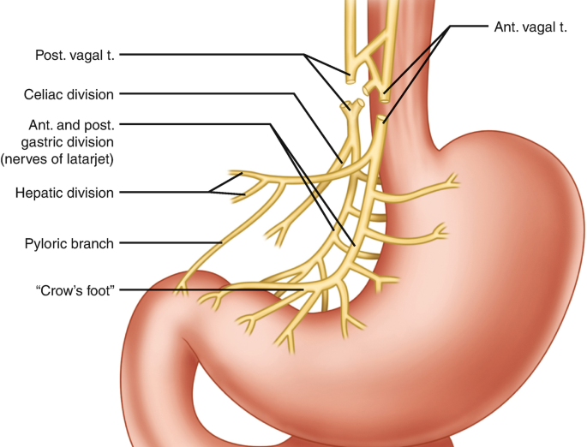
MIDGUT — GROSS ANATOMY
Stomach: Blood Supply & Innervation
Celiac trunk → left & right gastric, gastroepiploic arteries
Rich anastomoses along both curvatures
Venous drainage parallels arteries into the portal system
Autonomic nervous system
Parasympathetic via vagus n.
Digestion
Sympathetic via celiac plexus
Inhibition
GI System — Anatomy & Physiology
17 / 46

Slide 20
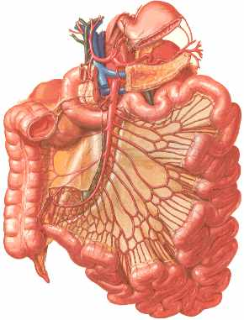
MIDGUT/HINDGUT — GROSS ANATOMY
Small Intestine: Three Segments
Duodenum — ~10–15 in, C-shaped, mostly retroperitoneal
Jejunum — ~8–9 ft, proximal 2/5
Ileum — ~10–11 ft, distal 3/5, ends at ileocecal valve
Function: site of most chemical digestion and nearly all nutrient absorption
GI System — Anatomy & Physiology
18 / 46

Slide 21
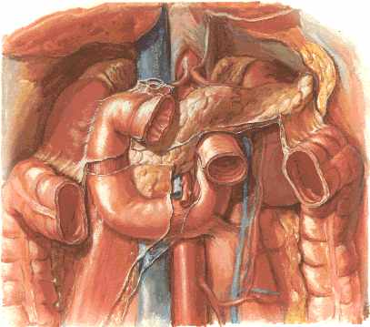
MIDGUT/HINDGUT — GROSS ANATOMY
Duodenum: Four Parts
Superior → descending → horizontal → ascending
Head of pancreas sits in the C-loop
Major papilla — bile + main pancreatic duct
Function: neutralizes acidic chyme and mixes it with bile & pancreatic enzymes
GI System — Anatomy & Physiology
19 / 46

Slide 22
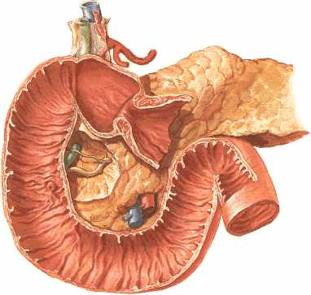
MIDGUT/HINDGUT — GROSS ANATOMY
Duodenum: Interior Surface
Duodenal cap (bulb) — smooth proximal segment
Brunner's glands neutralize acidic chyme
Circular folds (plicae circulares) begin here
GI System — Anatomy & Physiology
20 / 46

Slide 23
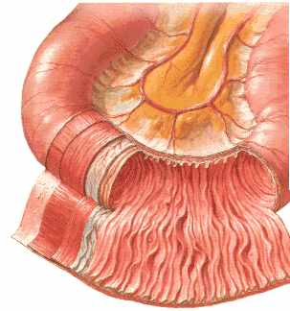
MIDGUT/HINDGUT — GROSS ANATOMY
Jejunum vs. Ileum
Jejunum — thicker wall, taller plicae circulares; bulk of nutrient absorption
Ileum — thinner wall, Peyer's patches; immune surveillance
Vascular arcades: fewer/longer (jejunum) vs. more/shorter (ileum)
GI System — Anatomy & Physiology
21 / 46

Slide 24
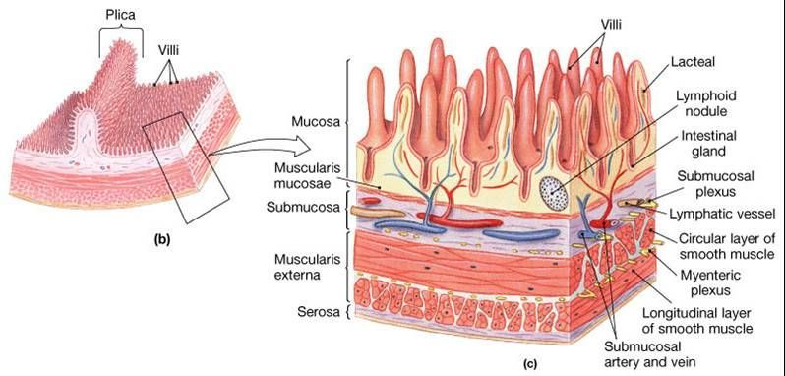
MIDGUT/HINDGUT — MICROANATOMY
Small Intestine: Wall Microanatomy
Plicae circulares → villi → microvilli amplify surface area
Enterocytes — brush-border digestion & absorption
Goblet cells (mucus) & Paneth cells (defense) in the crypts
GI System — Anatomy & Physiology
22 / 46

Slide 25
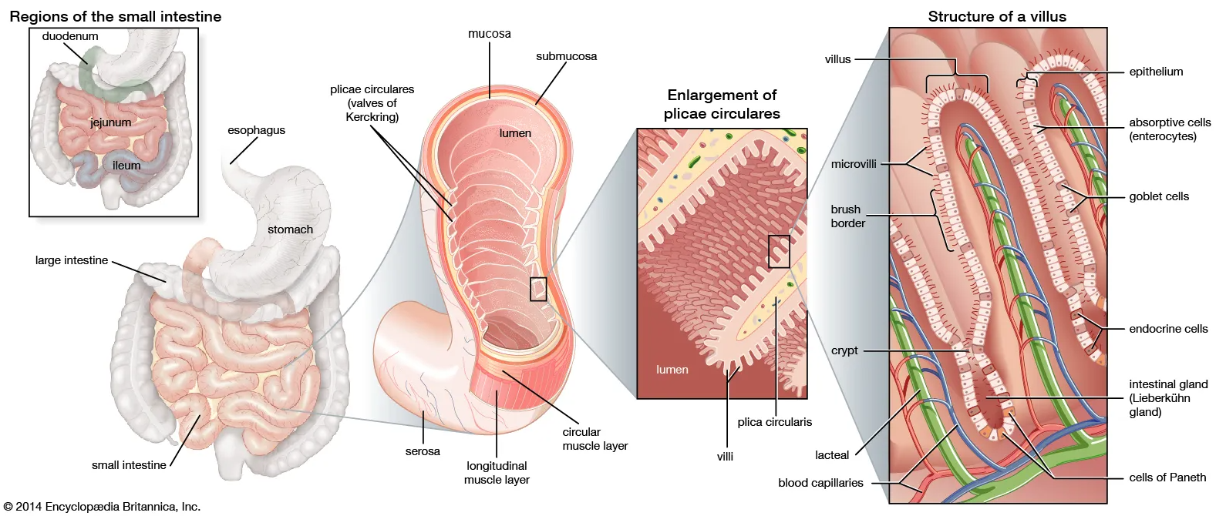
MIDGUT/HINDGUT — MICROANATOMY
Small Intestine: Wall Microanatomy
GI System — Anatomy & Physiology
22 / 46

Slide 26
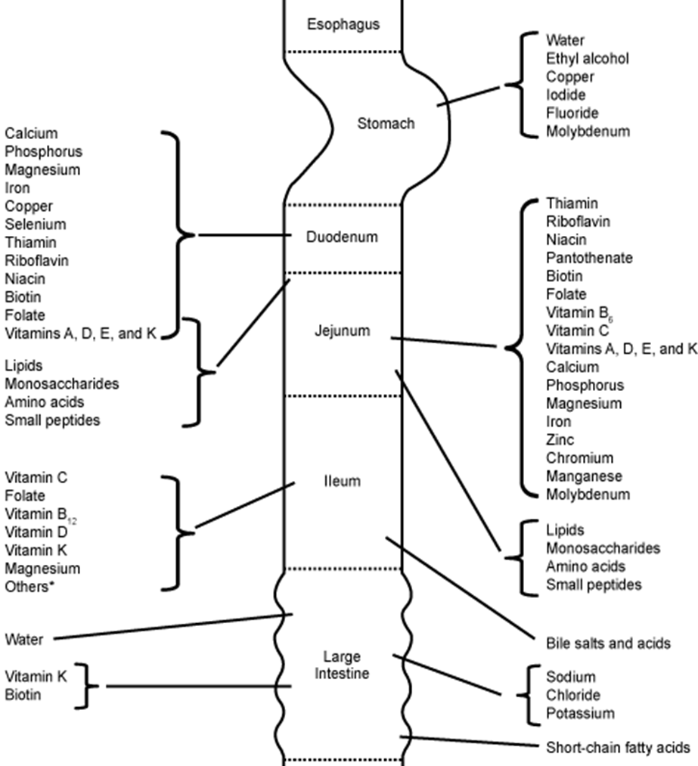
MIDGUT/HINDGUT — PHYSIOLOGY (REVIEW)
Absorption by Region
Duodenum/jejunum — sugars, amino acids, fats, iron, calcium
Ileum — bile salts & vitamin B12 (needs intrinsic factor)
Water & electrolytes absorbed along the entire length
GI System — Anatomy & Physiology
23 / 46

Slide 27
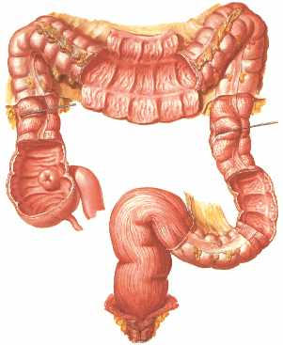
HINDGUT — GROSS ANATOMY
Large Intestine: Gross Anatomy
Cecum → ascending → transverse → descending → sigmoid → rectum
Teniae coli, haustra & epiploic appendages are unique to the colon
Function: reabsorbs water/electrolytes and forms & stores feces along this path
GI System — Anatomy & Physiology
24 / 46

Slide 28
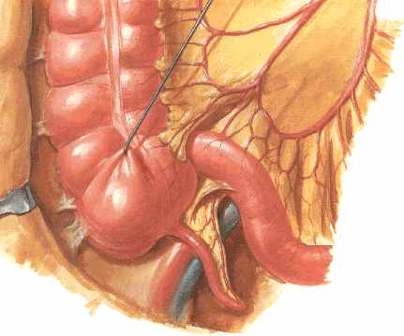
HINDGUT — GROSS ANATOMY
Cecum & Vermiform Appendix
Cecum receives the terminal ileum at the ileocecal valve
Appendix base is a fairly constant landmark (McBurney's point)
Appendix contains abundant lymphoid tissue
GI System — Anatomy & Physiology
25 / 46

Slide 29
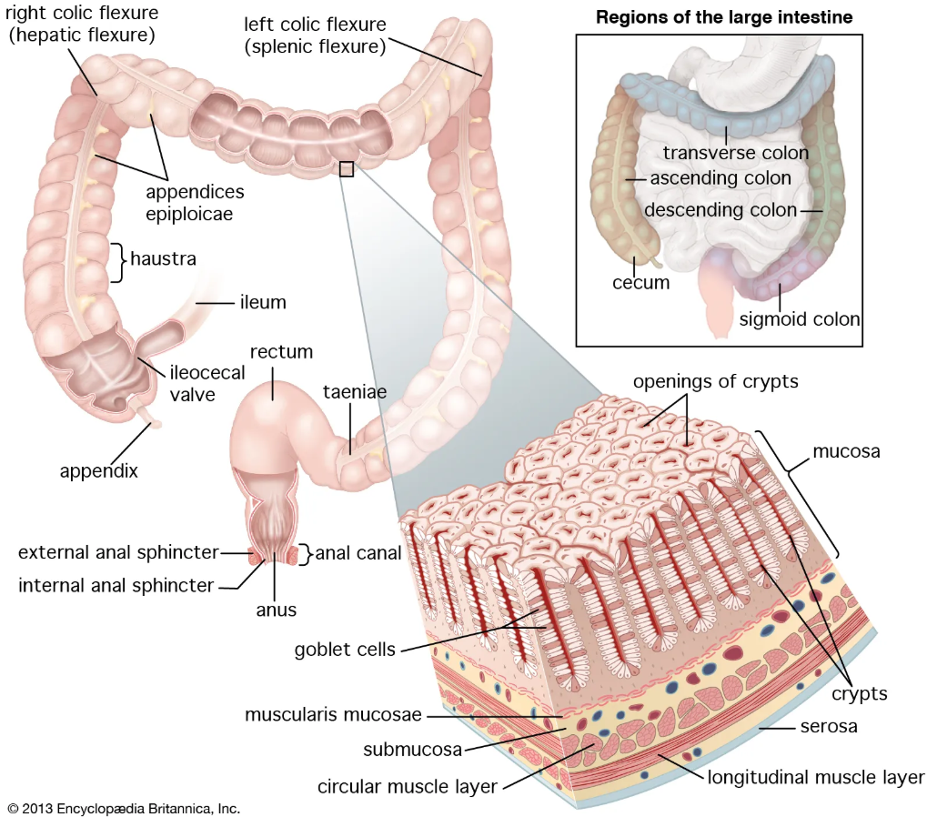
HINDGUT — MICROANATOMY
Colon: Microanatomy
No villi — flat mucosa with straight crypts, abundant goblet cells
Colonocytes absorb water, electrolytes & short-chain fatty acids
Microbiota ferment fiber → SCFAs; synthesize vitamin K
Haustral churning + mass movements drive defecation reflex
GI System — Anatomy & Physiology
26 / 46

Slide 30
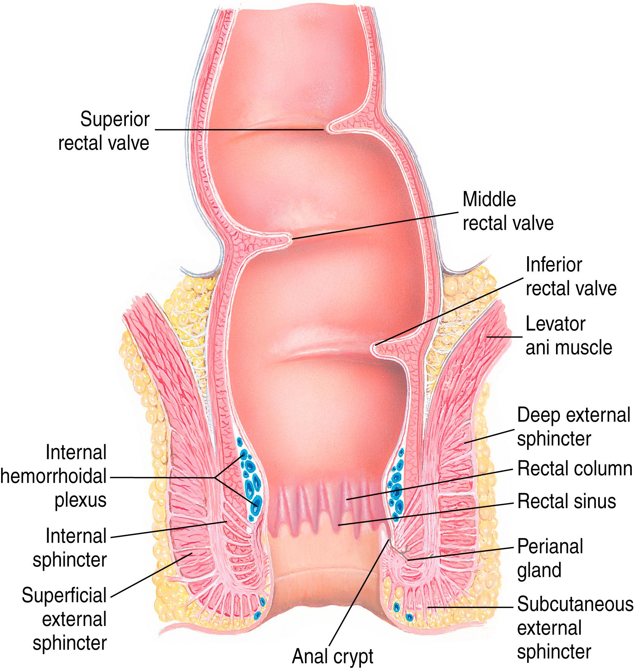
HINDGUT — ANATOMY
Rectum
12 to 15 cm muscular tube connecting the sigmoid colon to the anal canal
Primary function:
Temporary storage site for feces
When filled, its walls stretch, triggering nerve signals to the brain that create the urge to defecate
Internal & external sphincters
GI System — Anatomy & Physiology
26 / 46

Slide 31
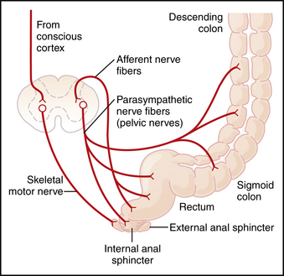
HINDGUT — ANATOMY
Rectum
Innervation:
autonomic (involuntary)
Fibers from sacral spinal cord (S2-S4) via pelvic splanchnic nerves
Stimulate rectal contraction + relax internal anal sphincter → defecation
somatic (voluntary)
Fibers from lumbar spinal cord (L1-L2) via lumbar splanchnic nerves
Relax rectal wall + contract internal sphincter → continence
GI System — Anatomy & Physiology
26 / 46

Slide 32
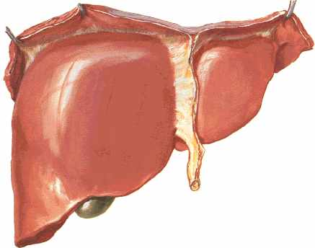
ACCESSORY ORGANS — GROSS ANATOMY
Liver: Diaphragmatic Surface
Largest solid organ & largest gland in the body
Right lobe & left lobe divided by the falciform ligament
Falciform ligament anchors to the anterior abdominal wall
Function: metabolism, detoxification, bile production — detailed a few slides ahead
GI System — Anatomy & Physiology
27 / 46

Slide 33
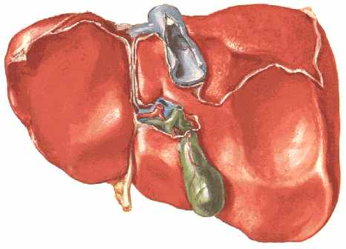
ACCESSORY ORGANS — GROSS ANATOMY
Liver: Visceral Surface & Lobes
4 anatomic lobes — right, left, caudate, quadrate
Porta hepatis: portal vein, hepatic artery, common hepatic duct
8 Couinaud segments guide surgical resection
GI System — Anatomy & Physiology
28 / 46

Slide 34
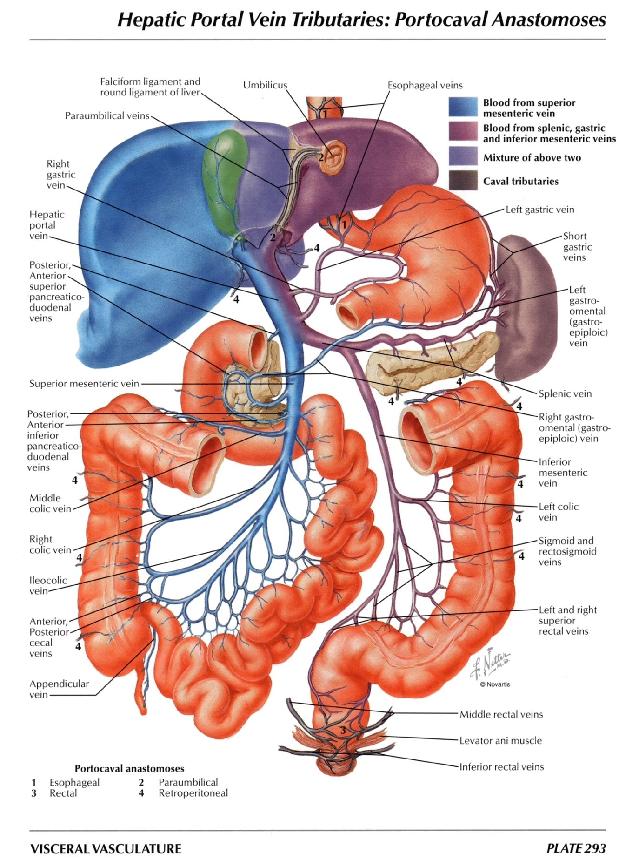
ACCESSORY ORGANS — GROSS ANATOMY
Hepatic Portal Circulation
Portal vein = superior mesenteric vein + splenic vein
Carries nutrient-rich, oxygen-poor blood from the gut & spleen to the liver first
Supplies ~75% of the liver's blood flow (hepatic artery supplies the rest)
Function: lets the liver process/detoxify absorbed nutrients before they reach systemic circulation
GI System — Anatomy & Physiology
29 / 46

Slide 35
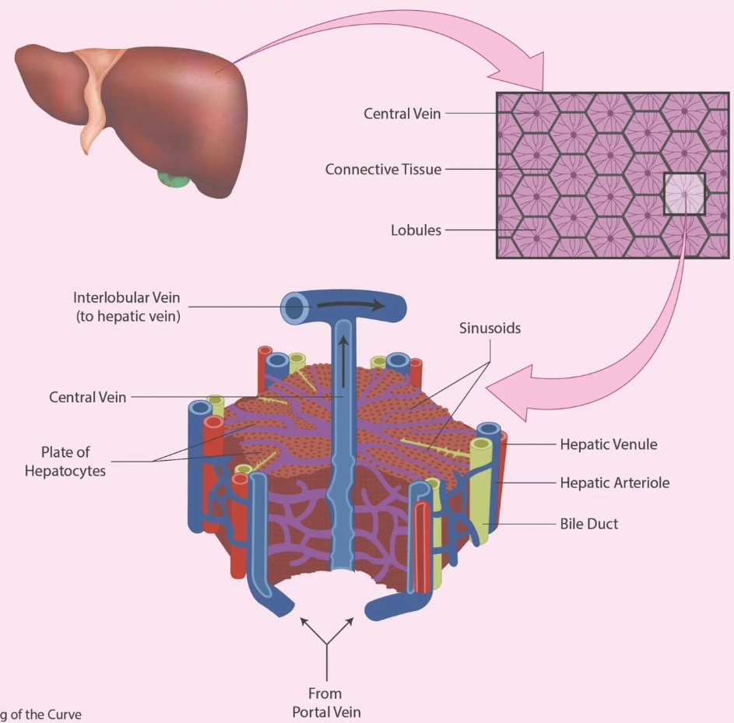
ACCESSORY ORGANS — MICROANATOMY
The Hepatic Lobule
Hepatocyte plates radiate from the central vein
Portal triad = vein, artery, bile duct
Blood flows from portal vein & hepatic artery (in portal triad) toward central vein via sinusoids
Sinusoids = fenestrated capillaries; patrolled by Kupffer cells
Bile flows opposite to blood: from hepatocytes → bile canaliculi → portal triad’s bile ducts
GI System — Anatomy & Physiology
30 / 46
Notes:
Each liver lobule consists of plates of hepatocytes arranged around a central vein, forming the liver’s basic structural unit. Between these plates lie sinusoids, channels that allow blood from the portal vein and hepatic artery to mix and flow toward the central vein. At the corners of each lobule lies a portal triad, made up of a branch of the hepatic artery, branch of the portal vein, and a bile duct.
This intricate network supports bidirectional flow: while blood moves inward toward the central vein, bile moves outward toward the bile ducts. This opposite movement ensures simultaneous filtration, detoxification, and bile secretion, all within the same microenvironment.

Slide 36
ACCESSORY ORGANS — PHYSIOLOGY (REVIEW)
Liver: Core Functions
Detoxification — Kupffer cells, drug/hormone breakdown, ammonia → urea
Carbohydrate & lipid metabolism — glycogen storage, triglyceride/cholesterol handling
Protein synthesis — albumin, clotting factors
Bile secretion — bile salts from cholesterol, bilirubin excretion
GI System — Anatomy & Physiology
31 / 46

Slide 37
ACCESSORY ORGANS — PHYSIOLOGY (REVIEW)
Bile & Bilirubin (Brief Review)
Bile: bile salts, bilirubin, cholesterol, electrolytes
Bile salts emulsify fat; most are recycled (enterohepatic circulation)
Heme → unconjugated bilirubin → liver conjugates it → excreted in bile
Direct/indirect split helps localize jaundice clinically
GI System — Anatomy & Physiology
32 / 46

Slide 38
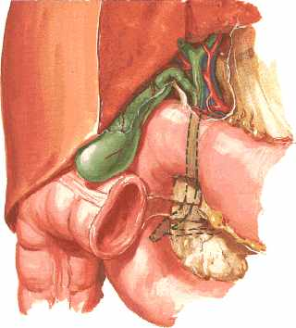
ACCESSORY ORGANS — GROSS ANATOMY
Biliary Tree & Gallbladder
Right + left hepatic ducts → common hepatic duct
Gallbladder stores/concentrates bile via the cystic duct
Common bile duct joins the pancreatic duct at the ampulla of Vater
GI System — Anatomy & Physiology
33 / 46

Slide 39
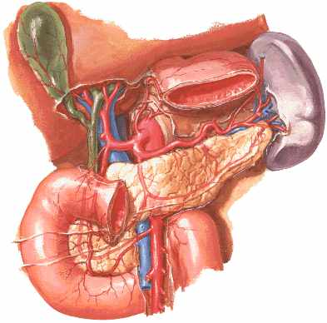
ACCESSORY ORGANS — GROSS ANATOMY
Cystic Triangle (of Calot)
Bounded by the cystic duct, common hepatic duct & liver edge
Contains the cystic artery
Key surgical landmark during cholecystectomy
GI System — Anatomy & Physiology
34 / 46

Slide 40
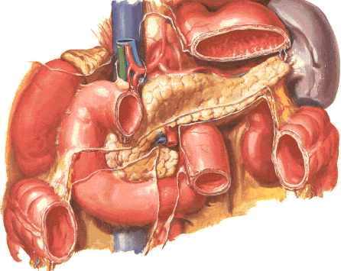
ACCESSORY ORGANS — GROSS ANATOMY
Pancreas: Gross Anatomy
Head, neck, body, tail — retroperitoneal
Head sits within the duodenal C-loop
Tail reaches toward the splenic hilum
Function: exocrine digestive enzymes + endocrine insulin/glucagon
GI System — Anatomy & Physiology
35 / 46

Slide 41
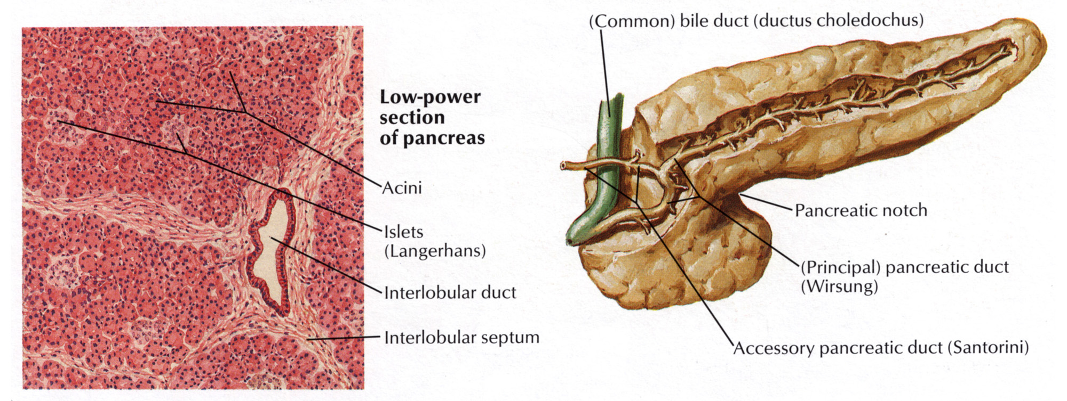
ACCESSORY ORGANS — GROSS ANATOMY
Pancreas: Duct System
Main duct (of Wirsung) runs the gland's length
Joins the common bile duct at the ampulla of Vater
Accessory duct (of Santorini) — minor papilla in many people
Function: delivers enzyme- and bicarbonate-rich secretions into the duodenum
GI System — Anatomy & Physiology
36 / 46

Slide 42
ACCESSORY ORGANS — PHYSIOLOGY (REVIEW)
Pancreas: Secretory Function
Exocrine (acinar cells) — amylase, lipase, proteases (as zymogens)
Ductal cells — bicarbonate neutralizes acidic chyme
Regulated by secretin (bicarbonate) & CCK (enzymes)
Endocrine islets — insulin (β) and glucagon (α); detail in Metabolism module
GI System — Anatomy & Physiology
37 / 46

Slide 43
SYSTEMS VIEW
Putting It Together: The Digestive Flow
Meal
↓
Stomach
↓
Duodenum
↓
Bile + Pancreatic Enzymes
↓
unabsorbed residue & water
Jejunum/Ileum (Absorption)
→
Colon (water absorption)
↓
↓
Portal Vein (Nutrients)
Rectum (feces & defecation)
↓
Liver
GI System — Anatomy & Physiology
38 / 46

Slide 44
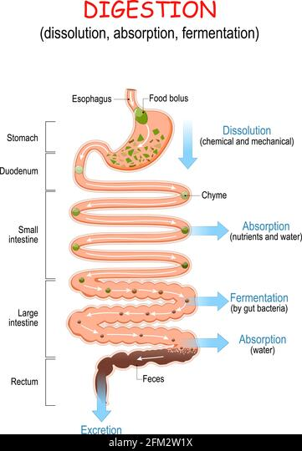
INTEGRATIVE ANATOMY
Waste regulation
Small intestine absorbs usable nutrients → indigestible matter (fiber, dead cells, bacteria) enters large intestine → colon removes water & electrolytes → bacteria ferment remaining carbohydrates → waste solidifies into feces
Normal feces: formed; either sausage-shaped with cracks, or sausage-shaped with smooth/soft surface
GI System — Anatomy & Physiology
40 / 46

Slide 45
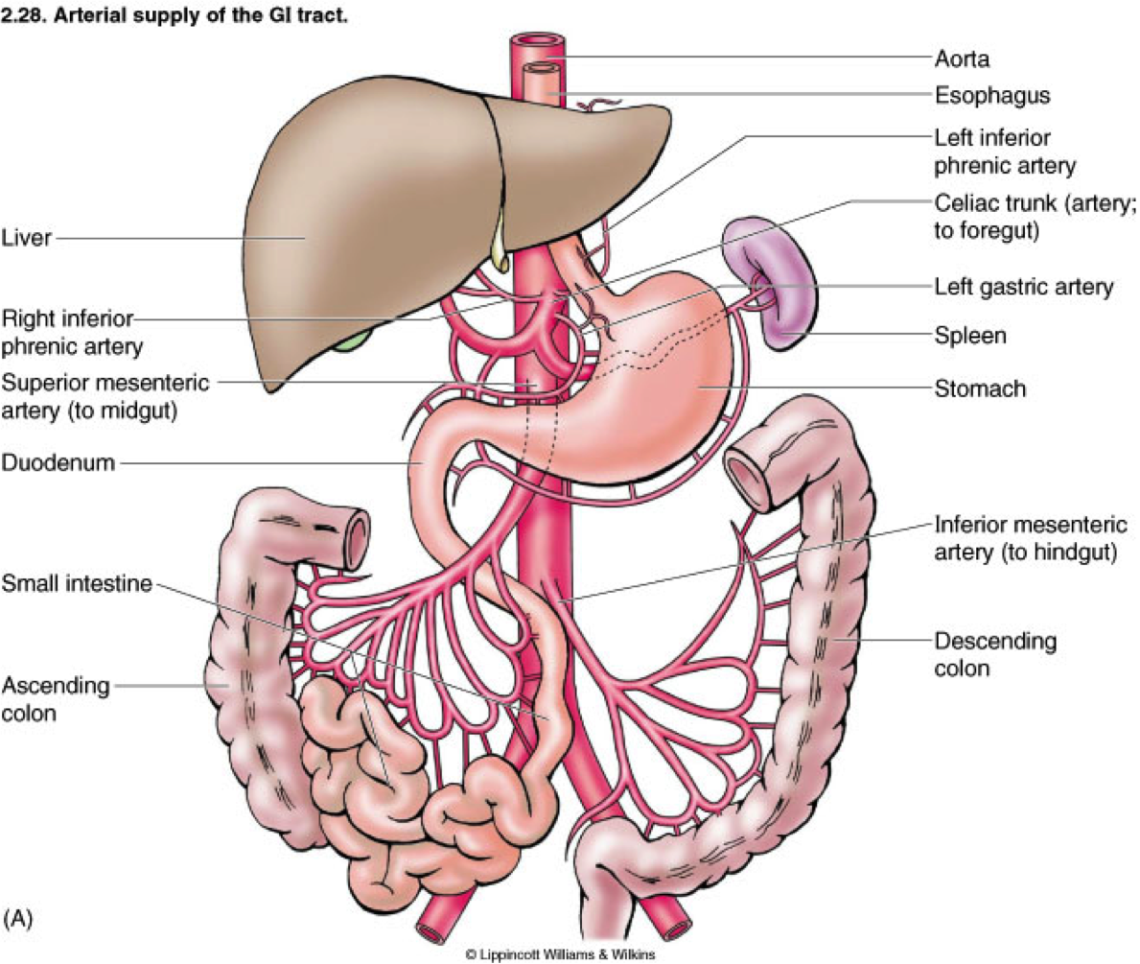
INTEGRATIVE ANATOMY
GI Vasculature
Celiac trunk — foregut (to major duodenal papilla)
Superior mesenteric artery — midgut (to transverse colon)
Inferior mesenteric artery — hindgut (to rectum)
GI System — Anatomy & Physiology
39 / 46

Slide 46
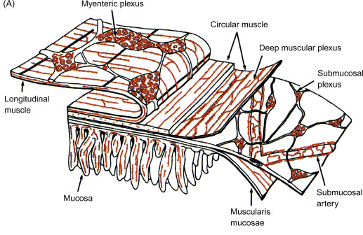
INTEGRATIVE ANATOMY
The Gut-Brain Axis & Enteric Nervous System (ENS)
ENS — the “second brain”
a massive network of 200-600 million neurons in the gut wall
Can function independently from the CNS
Major ENS plexuses:
Myenteric (Auerbach's) — between muscle layers → controls motility
Submucosal (Meissner's) — beneath mucosa → controls secretion & blood flow
Extrinsic CNS modulation of ENS:
Vagus nerve (parasympathetic) — generally stimulatory (promotes motility/secretion)
Sympathetic nerves — generally inhibitory (slows motility, reduces secretion
Communication pathways: Vagus n. (80% afferent), immune mediators, enteroendocrine hormones, microbial metabolites
90% of the body’s serotonin produced in gut but does not pass BBB
GI System — Anatomy & Physiology
40 / 46
Notes:
Gut-Brain Axis & Enteric Nervous System (ENS)
~95% of the body's serotonin is produced in the gut (enterochromaffin cells), but does not cross the blood-brain barrier — central and peripheral serotonin pools are functionally separate [8-9]
Clinical relevance: gut-brain axis dysfunction is implicated in IBS, functional dyspepsia, Parkinson disease (early ENS α-synuclein pathology), and mood disorders

Slide 47
PULLING IT TOGETHER
Motility & Regulation
How the tract moves food and coordinates itself

Slide 48
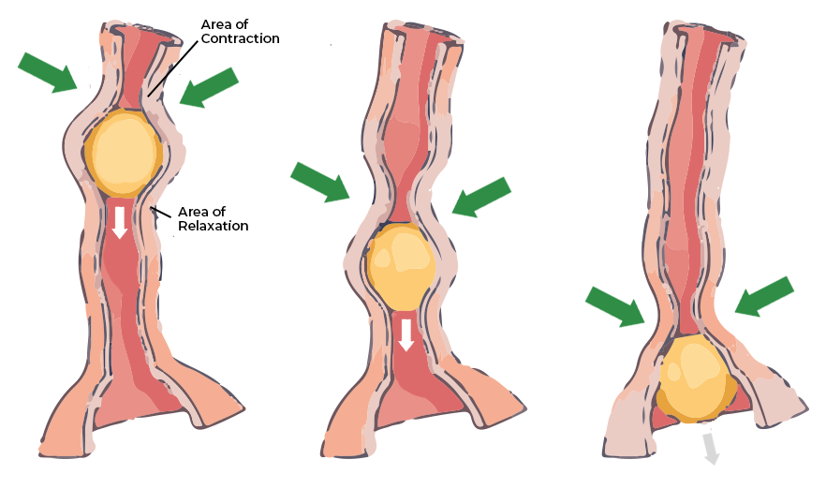
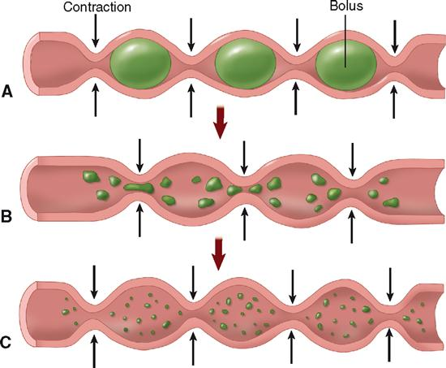
MOTILITY
Peristalsis & Segmentation
Peristalsis — coordinated wave of contraction behind + relaxation ahead of the bolus; propels contents forward
Segmentation — localized ring contractions in the small intestine; mixes chyme with enzymes/bile rather than propelling it
Both depend on the enteric nervous system, modulated by the vagus and sympathetics
GI System — Anatomy & Physiology
42 / 46

Slide 49
REGULATION
GI Hormones I: The Core Three
Gastrin
G cells (antrum) — ↑ gastric acid secretion
Secretin
S cells (duodenum) — ↑ bicarbonate, ↓ gastric acid
CCK
I cells (duodenum) — ↑ pancreatic enzymes & bile release
GI System — Anatomy & Physiology
43 / 46

Slide 50
REGULATION
GI Hormones II: The Incretins & Motilin
GIP
K cells (duodenum/jejunum) — ↑ insulin release (incretin effect)
GLP-1
L cells (ileum/colon) — ↑ insulin, ↓ gastric emptying & appetite
Motilin
M cells (duodenum) — triggers the migrating motor complex
GI System — Anatomy & Physiology
44 / 46

Slide 51
A FIRST LOOK
GI Diagnostics & Imaging:
Getting Familiar
Which tests exist and what they show

Slide 52
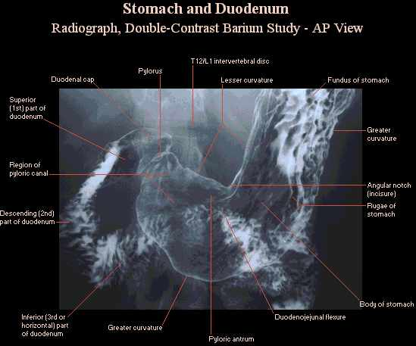
DIAGNOSTICS — BY ORGAN
Esophagus & Stomach: Diagnostics
Barium swallow — fluoroscopy (real-time X-ray) while swallowing contrast; shows contour, motility, strictures
EGD (esophagogastroduodenoscopy) — flexible scope passed through the mouth for direct visualization + biopsy
Pictured: upper GI series (barium contrast, AP view)
GI System — Anatomy & Physiology
46 / 46

Slide 53
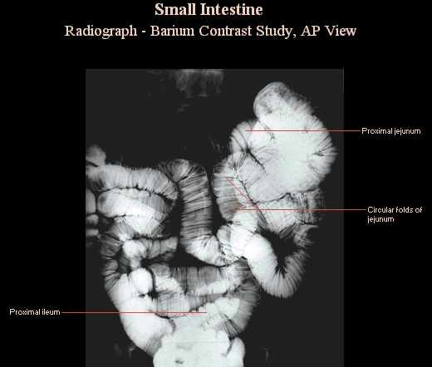
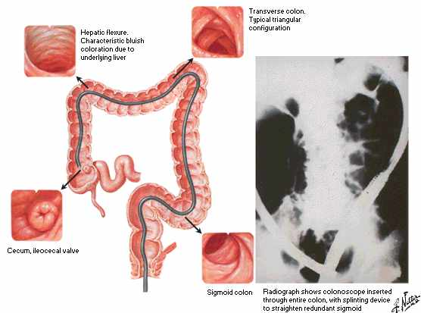
DIAGNOSTICS — BY ORGAN
Small Bowel & Colon: Diagnostics
Lower GI Series
Colonoscopy
Capsule endoscopy — swallowed pill camera images the small bowel as it passes through
Colonoscopy — flexible scope via the anus; direct visualization, biopsy & CRC screening
GI System — Anatomy & Physiology
47 / 46

Slide 54
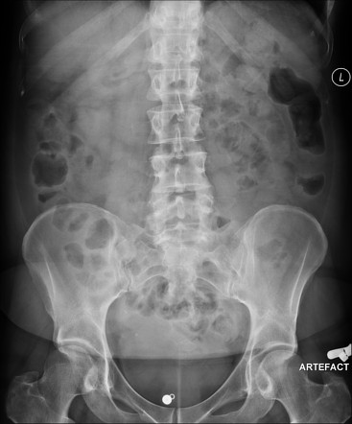
DIAGNOSTICS — BY ORGAN
Small Bowel & Colon: Diagnostics
Abdominal X-ray
Bowel gas patterns
Fecal material
Solid organs
Psoas muscles outline
Boney structures
Normal
GI System — Anatomy & Physiology
47 / 46
Notes:
A comprehensive evaluation of a normal abdominal radiograph includes the following specific features:
Bowel Gas Patterns & Distribution:Small Bowel: Typically located centrally. The folds (valvulae conniventes) run all the way across the diameter of the lumen. Gas is generally minimal.
Large Bowel: Located peripherally. The folds (haustra) are thicker but only run partially across the bowel, and it normally contains a mixture of gas and fecal material. [1, 2, 3, 4]
Solid Organs: The kidneys should be visible as smooth, bean-shaped, soft-tissue shadows. The liver and spleen outlines may be subtly distinguished. [1, 2, 3]
Soft Tissue & Muscle Margins: The sharp, triangular outlines of the psoas muscles on either side of the lumbar spine should be crisp and uninterrupted (loss of this margin can indicate retroperitoneal issues). [1, 2]
Bone Structures: The lower ribs, lumbar vertebrae, sacrum, pelvis, and femoral heads should be clearly visible without fractures or suspicious lesions. [1, 2]
No Pathological Calcifications: The X-ray should be free of abnormal calcifications (like kidney or gallstones), and show no signs of extraluminal (free) air

Slide 55
DIAGNOSTICS — BY ORGAN
Liver: Diagnostics
Lab tests
AST/ALT — enzymes released when hepatocytes are injured (ALT more liver-specific)
Bilirubin (direct vs. indirect) — blood test that helps localize the cause of jaundice
Liver panel = enzymes and proteins such as ALT, AST, ALP, bilirubin, albumin
Ultrasound — most widely used liver imaging, first-line; sound-wave imaging, no radiation; quickly detects liver structure/tumors/gallstones
CT – detailed cross-sectional x-ray images; detects tumors, abscesses, trauma, cancer staging
MRI – superior to CT for characterizing liver lesions, fatty liver disease
Elastography (FibroScan or MR Elastography) – noninvasive; measurue liver fibrosis & fat content; may replace need for liver biopsy
GI System — Anatomy & Physiology
48 / 46

Slide 56
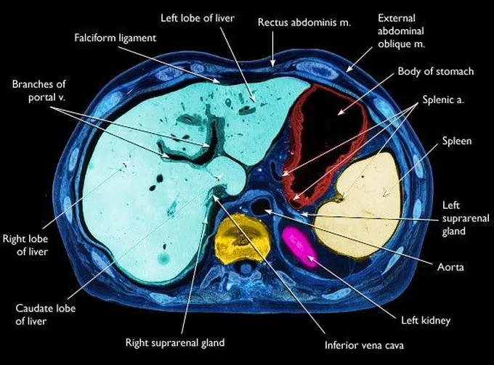
DIAGNOSTICS — BY ORGAN
Liver: Diagnostics
GI System — Anatomy & Physiology
48 / 46
Notes:
CT liver

Slide 57




DIAGNOSTICS — BY ORGAN
Gallbladder & Biliary Tree: Diagnostics
HIDA scan
Cholecystogram
MRCP
Ultrasound (first-line) or HIDA scan (nuclear tracer tests gallbladder emptying)
Cholecystogram – patient swallows iodine-based contrast, which liver excretes into bile, then x-rays taken
MRCP — noninvasive MRI of the bile ducts
GI System — Anatomy & Physiology
49 / 46
Notes:
HIDA = hepatobiliary iminodiacetic acid
cholecystogram (or oral cholecystogram) is an X-ray exam used to evaluate the gallbladder. Patients swallow an iodine-based contrast tablet the night before, which the liver excretes into the bile, making the gallbladder visible on an X-ray. It is mostly used to diagnose gallstones

Slide 58

DIAGNOSTICS — BY ORGAN
Gallbladder & Biliary Tree: Diagnostics
ERCP = Endoscopic Retrograde Cholangiopancreatography
invasive scope + X-ray
Diagnose and treat
Assesses liver, pancreas, bile ducts
Used to remove gallstones or pancreatic stones, place stents, check for strictures or leaks, identify tumors, take biopsies
GI System — Anatomy & Physiology
ERCP
49 / 46

Slide 59

DIAGNOSTICS — BY ORGAN
Pancreas: Diagnostics
Labs
Lipase — enzyme released with pancreatic injury; more pancreas-specific than amylase
CT abdomen/pelvis —gold standard, first-line for pancreatitis or a mass
MRCP
Endoscopic Ultrasound (EUS)
Abdominal Ultrasound
GI System — Anatomy & Physiology
50 / 46
Notes:
CT: "dual-phase" or "multiphase" CT with intravenous contrast is almost always used to highlight blood vessels and pinpoint tumors
MRCP: when CT results are unclear or when better visualization of the bile and pancreatic ducts is needed
EUS: highest resolution for smaller lesions. A doctor passes a specialized endoscope down the throat to the stomach to get detailed, close-up ultrasound images of the pancreas. It also allows the doctor to perform a fine-needle biopsy if a mass is found
Abdominal US: Often the first non-invasive test ordered for symptoms like jaundice to rule out gallstones. However, its effectiveness is often limited by overlying bowel gas

Slide 60
DIAGNOSTICS — CROSS-CUTTING
Other Diagnostics You'll See Again
Plain abdominal X-ray (KUB) — quick look for free air, obstruction, bowel gas pattern
Stool studies — fecal occult blood/FIT (bleeding), fecal calprotectin (inflammation)
H. pylori testing — urea breath test, stool antigen, or biopsy at EGD
Tumor markers — CEA followed serially after colorectal cancer treatment
GI System — Anatomy & Physiology
51 / 46

Slide 61
QUICK REFERENCE
Acronyms at a Glance
EGD
Esophagogastroduodenoscopy
ERCP
Endoscopic retrograde cholangiopancreatography
MRCP
Magnetic resonance cholangiopancreatography
HIDA
Hepatobiliary iminodiacetic acid (scan)
CT
Computed tomography
KUB
Kidneys, ureters, bladder (plain abdominal X-ray)
GI System — Anatomy & Physiology
52 / 46

Slide 62
CLINICAL CORRELATION
Choosing the Right Study
Suspected appendicitis
CT (adult) or ultrasound (child/pregnant)
RUQ pain, gallstones
Ultrasound ± HIDA scan
Dysphagia
Barium swallow ± manometry
Colorectal cancer screening
Colonoscopy
Suspected pancreatitis
Lipase + CT abdomen/pelvis
Abnormal LFTs
AST/ALT, bilirubin → ultrasound
Suspected PUD/gastritis
H. pylori testing ± EGD
GI System — Anatomy & Physiology
53 / 46

Slide 63
WRAP-UP
Key Takeaways
Four wall layers, regionally specialized, run the whole GI tract
Accessory organs share one ductal system at the ampulla of Vater, and the portal vein routes absorbed nutrients to the liver first
Foregut/midgut/hindgut map to celiac/SMA/IMA blood supply
Motility (peristalsis/segmentation) and hormones (gastrin, secretin, CCK, GIP, GLP-1, motilin) coordinate the whole process
Imaging & lab choice always follows the clinical question — you'll see these tests again in each disease lecture
GI System — Anatomy & Physiology
54 / 46

Slide 64
Questions & Discussion
Next up: GI A&P Lab session

